Slide 1
The Stack and Introduction to Procedures
Course Code: CSC 2106
Course Title: Computer Organization and Architecture
Dept. of Computer Science
Faculty of Science and Technology
Lecturer No: | 8 | Week No: | 12 | Semester: | Fall 23-24
Lecturer: | Nusrat Jahan Anannya, anannya@aiub.edu

Slide 2
Lecture Outline
The stack segment of a program is used for temporary storage of data and addresses.
In this chapter we will see how the stack is manipulated.
How stack is used to implement procedures.
The PUSH and POP Instructions that add and remove words from the stack.
Because the last word to be added to the stack Is the first to be removed(LIFO), A stack can be used to reverse a list of data
.

Slide 3
Lecture Outline
Procedures are extremely important in all programming language.
We will discuss the essentials of assembly language procedures.
At the machine level, we can see exactly how a procedure is called and how it returns to the calling program.
An example of procedure will be discussed to perform the binary multiplications and DEBUG program.

Slide 4
The Stack
A stack is one-dimensional data structure.
Items are added and removed from one end of the structure; that is, it is processed in a "last-in, first-out" manner.
The most recent addition to the stack is called the top of the stack.
A familiar example is a Stack of dishes; the last dish to go on the stack is the top one, and it's the only one that can be removed easily.
A program must set aside a block of memory to hold the stack.
We have been doing this by declaring a stack segment. For example,
    .STACK lOOH

Slide 5
A stack is a one-dimensional data structure where items are added and removed from one end only—the top. It follows LIFO (Last-In, First-Out) order.
Example: A stack of dishes—the last dish placed on top is the first to be removed.
In assembly, a program must reserve memory for the stack using a stack segment, e.g.:

Slide 6
The Stack(cont’d…)
When the program is assembled and loaded in memory , SS will contain the segment number of the stack segment.
For the preceding Stack declaration, SP, the stack pointer, is initialized to 1OOh.
This represents empty stack position.
When the stack is empty, SP contains the offset address of the top of the stack.

Slide 7
SS (Stack Segment register) holds the segment address of the stack.
SP (Stack Pointer) is initialized to 100H (top of the empty stack).
When the stack is empty, SP points to the top of the stack.

Slide 8
PUSH AND PUSHF
PUSH is used to add new word to the stack.
The syntax is:
PUSH Source (i.e. PUSH AX)
  SP is decreased by 2
  A copy of source content is moved to the address specified by SS:SP.
Initially, SP contains the offset address of memory location.
The first PUSH decreases SP by 2 and point to the LAST WORD in the STACK segment.
PUSHF has no operands and pushes the contents of the flag register to the stack.

Slide 9
Stack Analogy – Stack of Books
Imagine a stack of books on a table.
PUSH → you add a new book on top.
  You always place it on the top, never the bottom.
  The top book is now the most recent one added.
SP (Stack Pointer) → your hand pointing to the top book.
  When you add a book, your hand moves down the stack (like memory address decreasing in assembly).
PUSHF → like placing a special bookmark (the flags) on top of the stack.
✅ Key idea: You always add (PUSH) on top, and SP tracks the top position.

Slide 10
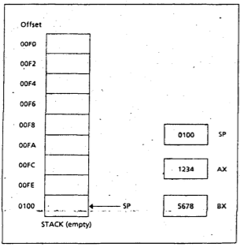
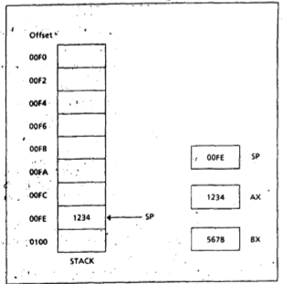
PUSH OPERATION

Slide 11
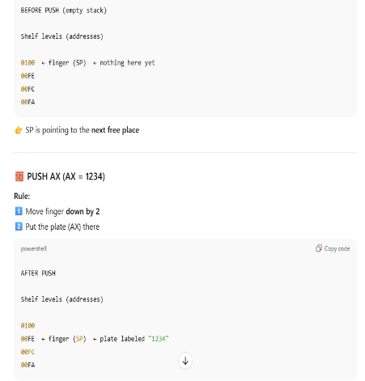
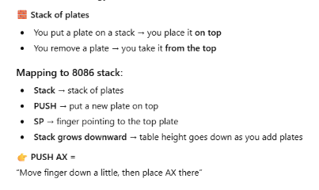

Slide 12
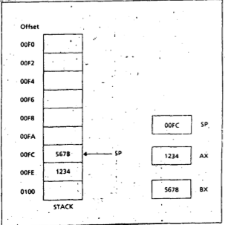
PUSH OPERATION (cont’d…)

Slide 13
POP AND POPF
POP is used to remove an item from the stack.
The syntax is:
POP destination (i.e. POP AX)
  The content of SS:SP (the top of the stack) Is moved to the destination.
  SP is Increased by 2.
The Instruction POPF, pops the top of the stack into the FLAGS register.

Slide 14
POP AND POPF
There is no effect of PUSH, PUSHF. POP, POPF on the flags.
Note that PUSH and POP are word operations, so a byte Instruction(i.e. PUSH DL or PUSH 2) is illegal.
For INT 21h DOS saves instructions in STACK before execution.

Slide 15
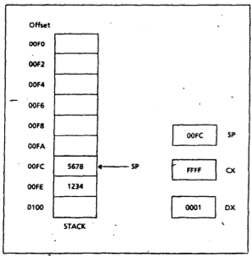
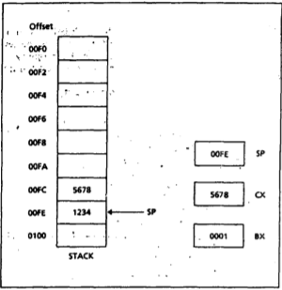
POP OPERATION

Slide 16
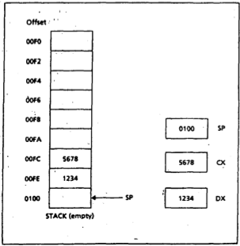
POP OPERATION (cont’d…)

Slide 17
STACK Application
Algorithm to Reverse Input
Go to a new 1ine
FOR count times DO
pop a character from the stack;
display it;
END FOR
Display a '?'
Initialize count to 0
Read a character
WHILE character is not a carriage return DO
push character onto the stack
increment count
read a character
END WHILE:

Slide 18
Terminology of Procedures
The idea is to take the original problem and decompose it into a series of sub problems that are easier to solve than the original.
Like high level languages, an assembly language program can also be structured as a collection of procedures.
One of the procedures is the main procedure containing the entry point to the program.
To carry out a task the main procedure calls one of the other procedures. It is also possible for these procedures to call each other or for a procedure to call itself.
Procedure declaration:
name PROC type
; body of the procedure
RET
name ENDP

Slide 19
Procedure Call and Return
Name is the user defined name of the procedure.
Near: It means that the statement that calls the procedure is in the same segment as the procedure it self.
Far: It means that the calling statement is in the a different segment.

Slide 20
Procedure Call and Return ( cont’d…)
Ret : The ret instruction causes control to transfer back to the calling procedure.
Every procedure should have a ret someplace (except main procedure)

Slide 21
References
Assembly Language Programming and Organization of the IBM PC, Ytha Yu and Charles Marut, McGraw Hill, 1992. (ISBN: 0-07-072692-2).
https://www.csie.ntu.edu.tw/~cyy/courses/assembly/10fall/lectures/handouts/lec15_x86procedure_4up.pdf

Slide 22
Books
Assembly Language Programming and Organization of the IBM PC, Ytha Yu and Charles Marut, McGraw Hill, 1992. (ISBN: 0-07-072692-2).
Essentials of Computer Organization and Architecture, (Third Edition), Linda Null and Julia Lobur
W. Stallings, “Computer Organization and Architecture: Designing for performance”, 67h Edition, Prentice Hall of India, 2003, ISBN 81 – 203 – 2962 – 7
Computer Organization and Architecture by John P. Haynes.

